Slide 1

Restaurants in toronto
Ayush Dallakoti

Slide 2
Introduction
This is apart of the IBM Applied Data Science Capstone project.
For this project, we are required to come up with a hypothetical business problem where we can utilise our data science knowledge and skills to solve a business problem.
Within this report, I talk about the business problem, the data getting evaluated to solve the business problem, the method being used, and results of the data getting analysed.

Slide 3
Business problem
The Gupta’s have planned to migrate to Toronto, Canada.
They have been running a family hospitality business for many years in India.
Since they are moving to Toronto, they are planning on opening their hospitality business in the city of Toronto, where they can grow their business whilst profiting.
This is a new place for them, so they are not sure what the best location is for opening a Indian restaurant.
The objective of our project is to help the Gupta’s find a great location for opening a business in Toronto using the skills and knowledge of data science.

Slide 4
Data
The data getting used for analysis are as follows:
List of neighbourhoods in Toronto.
Geospatial coordinates of neighbourhoods in Toronto.
Data of venues related to Indian restaurants.

Slide 5
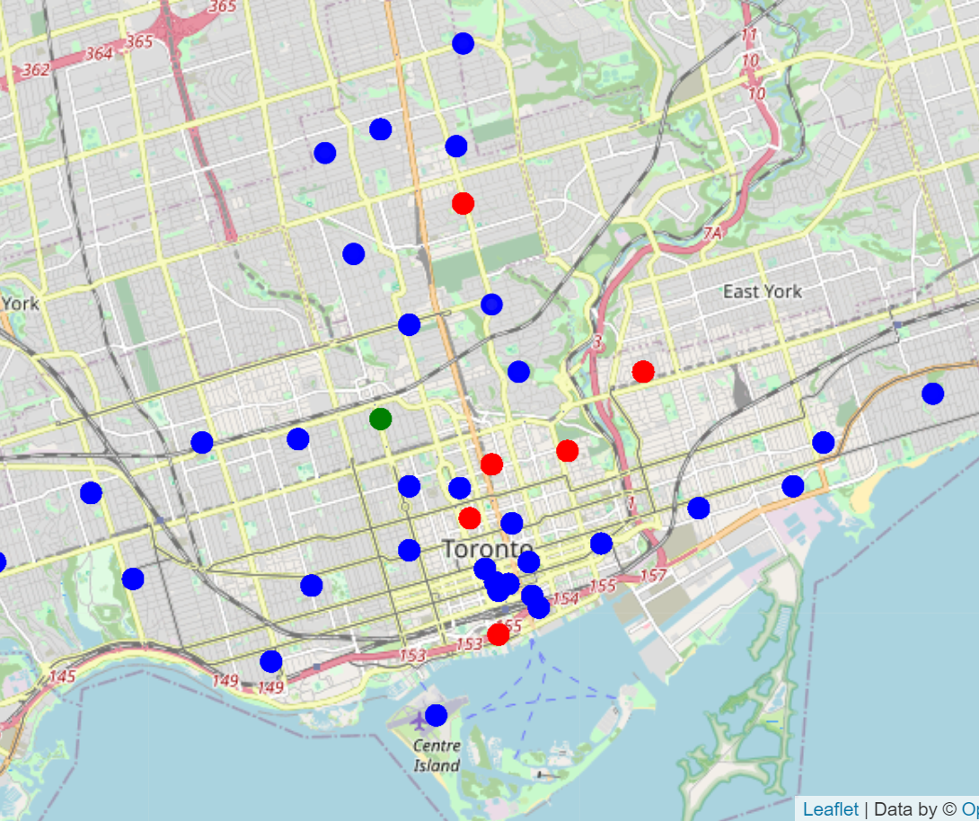
Results
Below is a summary of the clustering of Indian restaurants in the city of Toronto, Canada.
I used the K-Means to build 3 different clusters on how many Indian restaurants are in each neighbourhood.
Cluster 0 had the highest number of Indian restaurants. *Blue spots
Cluster 1 had no Indian restaurants. *Green spots
Cluster 2 had low number of restaurants. *Red spots

Slide 6
Conclusion
There is a large number of Indian restaurants already in cluster 0 which includes places like Riverdale, Davisville and Cabbagetown. So, opening a new Indian restaurant in that area would create conflicts with other already established Indian restaurants, so I would not recommend opening a new shop in this neighbourhood.
Cluster 1 has no effective Indian restaurants, therefore, I would highly recommend opening an Indian restaurant in this area, as there will be a new option of cuisine for the residents in this neighbourhood and since it is the only Indian restaurant in that area, there will high sale and demand for Indian food.

